Slide 1
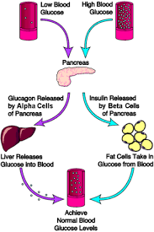
Glucose Regulation Process

Slide 2
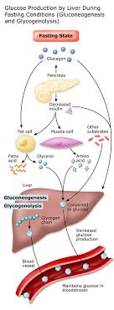
What is Glucose?
Glucose is found in human blood and is also referred to as glucose
Produced after the breakdown of carbohydrates, which act as a fuel of a body
Determined by the level of glucose in the blood
Tight glucose metabolism is essential for brain psychology
Glucose insufficiency leads to physiopathology based brain disorders
Notes:
Sugar particles are broken down into glucose that serves as fuel for the body. Sugar is used when carbohydrate is broken down in the digestive system. The blood carries glucose to cells. Glucose can also be made from protein or fat from the kidney or liver. Ljung, Nemhauser & Perata (2015) suggest that the mammalian brain depends upon glucose as its main source of energy, and tight regulation of glucose metabolism is critical for brain physiology. Glucose insufficiency is among the significant causes of physiopathology based brain disorders.

Slide 3
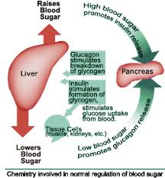
Sugar regulation
Maintenance of optimal blood glucose level
The result of glucose metabolism is the cellular use of glucose as an energy
Composed of various processes, including gluconeogenesis, glycogenesis, glycogenolysis, and glycolysis.
Sugar regulation demands to have counter-regulatory hormones
Insulin assistance is as well necessary for the process
Notes:
Glucose regulation is the process of managing optimal blood sugar levels. The philosophical outcome of sugar metabolism is the cellular use of glucose for energy (adenosine triphosphate synthesis). The breakdown of sugar to glycogen is composed of various biological processes, which include gluconeogenesis, glycogenesis, glycogenolysis, and glycolysis. It is worth noting that sugar regulation cannot work out effectively without counter regulatory hormones. Yamada, Saijo, Nakagami & Takano (2016) opine that sugar regulation requires the body to have an acceptable level of insulin.

Slide 4
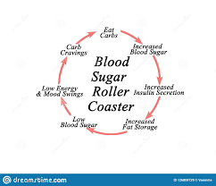
Categories of glucose regulation
Maintained within physiological limits by the rate of glucose entrance in the body.
Outcomes outside the acceptable range could indicate dysfunction in glucose regulation
The first category is Hypoglycemia, which represents sugar levels of less than 70 mg/dL
The second category is hyperglycemia which defines high blood sugar of more than 100 mg/dL
Unregulated blood sugar may lead to disorders including diabetes mellitus
Notes:
As pointed out earlier, glucose regulation is maintained within physiological limits by the rate of glucose entrance in the body. Cordoba et al. (2017) confirm that when the overall level of blood sugar ranges outside the acceptable levels, the condition indicates dysfunction in glucose regulation. The first category of glucose regulation outlined by Cordoba et al. (2017) is Hypoglycemia, which represents sugar levels of less than 70 mg/dL. The other category is hyperglycemia, which defines high blood sugar of more than 100 mg/dL (Cordoba et al., 2017). Importantly, unregulated blood sugar may lead to disorders, including diabetes mellitus.

Slide 5
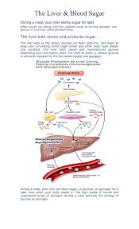
Absorptive and non-absorptive state
Blood sugar varies based on the level of food intake
Absorptive rate is evidenced immediately after food intake (nutrients are absorbed from the gut)
When blood sugar level rise, excess glucose is stored in the liver
Post absorptive state begins after digestion is complete.
Cells generate energy during the post-absorptive state.
Notes:
Blood-sugar levels changes as an individual’s intake of food fluctuate over 24 hours. The body is believed to be in an absorptive state after meals as it absorbs nutrients from the gut (Ljung, Nemhauser, Perata, 2015). Blood-sugar levels escalate; however, this is buffered by glucose storage in the liver. When digestion is complete, and the absorption of nutrients decreases, the body is in a post-absorptive state and, as the body's cells use glucose to make energy, blood-glucose levels fall (Ljung, Nemhauser, Perata, 2015).

Slide 6
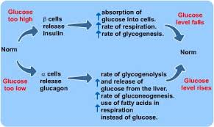
Functioning of pancreases
Digests and regulates glucose in the human body
Is composed of endocrine and exocrine enzymes
Has pancreatic beta cells for producing and storing insulin
Composed of alpha cells for secreting glucagon to increase plasma glucose levels.
Glucagon is used to breakdown glycogen stored in the liver.
Notes:
The primary purpose of the pancreas is to digests and regulates glucose in the human body. The organ generates two vital enzymes known as endocrine and exocrine, which aids in regulating the amount of sugar deposited into human blood. Ljung, Nemhauser, Perata (2015) enlighten that the pancreas is composed of beta cells, which contributes hugely towards sugar regulation by producing and storing insulin. Also, the organ has alpha cells used for secreting glucagon to increase plasma glucose levels. The produced glucagon aids in breaking down glycogen stored in the liver.

Slide 7
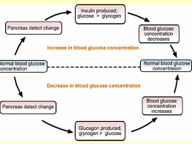
Response to low and high blood sugar
Low level of glucose in plasma stimulates the secretion of glycogen
Glycogenolysis and gluconeogenesis are encouraged by glycogen,
Thereby increasing the level of glucose in plasma.
When blood sugar is high, the pancreas releases insulin into the bloodstream
Insulin signals adipose cells to utilize glucose
Notes:
A low plasma glucose level triggers glucagon secretion from alpha cells of the pancreas. After the hormone glucagon is deposited into the bloodstream, it stimulates to hepatic glycogenolysis and gluconeogenesis, thereby escalating the plasma level of glucose (Cordoba et al., 2017). Once the glucose levels reach normal levels, the stimulus for glucagon will decrease. The elevated blood glucose alerts the pancreas to stimulate the secretion of insulin into the bloodstream (Cordoba et al., 2017). The insulin signals its target cells in the muscles for adipose tissue in the liver to permit glucose to utilize the glucose.

Slide 8
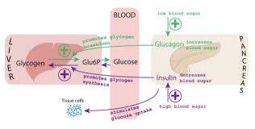
Insulin resistance
A situation when cells in the body do not respond appropriately to the hormone insulin
The body will produce more insulin when it becomes resistant to insulin
Insulin resistance is the primary cause of type 2 diabetes mellitus (DM), gestational DM and prediabetes
Insulin sensitivity comes in three types, peripheral, hepatic, and pancreatic.
Notes:
Insulin resistance is a situation whereby a body does not respond appropriately to the hormones. According to Cordoba et al. (2017), the body will produce more insulin when it becomes resistant to insulin. The previous research suggests that insulin resistance is the primary cause of type 2 diabetes mellitus (DM), gestational DM, and prediabetes (Cordoba et al., 2017). Apart from resistance, insulin sensitivity is also a necessary test to determine the rate of sugar absorption and is classified into three peripheral, hepatic, and pancreatic.

Slide 9

Clinical management
A standard diagnostic test may include glucose screening, lipid analysis, microalbuminuria, C-reactive protein
Prevented through taking an appropriate diet, exercising and weight control
Laboratory tests include hemoglobin A1c and cholesterol
Blood pressure screening to detect complications
Collaborative interventions are also done, for instance, education on insulin regulation
Notes:
Caregivers need to manage clinical procedures involving diabetes mellitus patients. The commonly practiced diagnostic test may include glucose screening, lipid analysis, microalbuminuria, C-reactive protein (Ljung, Nemhauser, Perata, 2015). Physicians need to advise diabetes patients on the most appropriate diet and methods of exercising, which would lead to weight loss. The disease needs to be analyzed with the aid of the various lab reports, including hemoglobin A1c and cholesterol (Ljung, Nemhauser, Perata, 2015). Notably, blood screening is crucial to people with diabetes in detecting complications as they begin. Importantly, collaborative interventions are also done, for instance, education on insulin regulation.

Slide 10

Type 1 diabetes mellitus
Less common, and it much less progressive
Associated with other autoimmune diseases-Celiac, Graves, Hashimotos and Addisons
Can be caused by certain drugs, foods or viruses
Impacts the metabolism of fats and carbs
The body digests proteins and fats since glycogen cannot be understood
Notes:
Type one Mellitus is less common as compared to type 2, and is also less progressive. A person suffering from celiac, Graves, Hashimotos, and Addison's stands a higher chance of contradicting the disease (Ljung, Nemhauser, Perata, 2015). Additionally, type 1diabettes Mellitus may be caused by various drugs, foods, or viruses (Cordoba et al., 2017). The disease impacts the normal functioning of the victim's body because of the metabolism of fats and carbs. Treatment and early recognition, including dynamic lifestyle changes, can aid in regulating disease advancement.

Slide 11
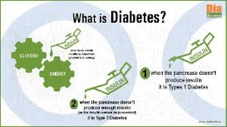
Type 2 diabetes mellitus
Non-Insulin Dependent Diabetes Mellitus
Common among American Indians and Native Alaskans
Is among the hereditary diseases
Hypoglycemia is one of the significant diabetes mellitus complications
Metabolic syndrome includes central obesity, dyslipidemia, and pre-hypertension
Notes:
Type 2 diabetes is as well-referred to as Non-Insulin Dependent Mellitus. The previous research has revealed that the disease is mostly found among American Indians and Native Alaskans. The genetic environment is responsible for the illness and is among the hereditary diseases (Cordoba et al., 2017). A type 2 diabetes patient may experience a number of complications, for instance, Hypoglycemia, glycosuria, dehydration, and hyperglycemia. The constellation of disorders referred to as Metabolic Syndrome, confer a high risk of developing Type 2 DM and the associated CV complications (Cordoba et al., 2017). Central obesity, dyslipidemia, and pre-hypertension are among the metabolic syndrome experienced by type 2 diabetes mellitus.

Slide 12
References
Cordoba, E., Aceves-Zamudio, D. L., Hernández-Bernal, A. F., Ramos-Vega, M., & León, P. (2015). Sugar regulation of SUGAR TRANSPORTER PROTEIN 1 (STP1) expression in Arabidopsis thaliana. Journal of experimental botany, 66(1), 147-159.
Ljung, K., Nemhauser, J. L., & Perata, P. (2015). New mechanistic links between sugar and hormone signalling networks. Current Opinion in Plant Biology, 25, 130-137.
Søberg, S., Sandholt, C. H., Jespersen, N. Z., Toft, U., Madsen, A. L., von Holstein-Rathlou, S., ... & Solomon, T. P. (2017). FGF21 is a sugar-induced hormone associated with sweet intake and preference in humans. Cell metabolism, 25(5), 1045-1053.
Yamada, K., Saijo, Y., Nakagami, H., & Takano, Y. (2016). Regulation of sugar transporter activity for antibacterial defense in Arabidopsis. Science, 354(6318), 1427-1430.

